Slide 1
Rough designs from Tableau

Slide 2
Explaination
The original data was lost when my adapted machine broke.
I had a small amount of the data in another file, however, the data was saved in powerpoint format

Slide 3
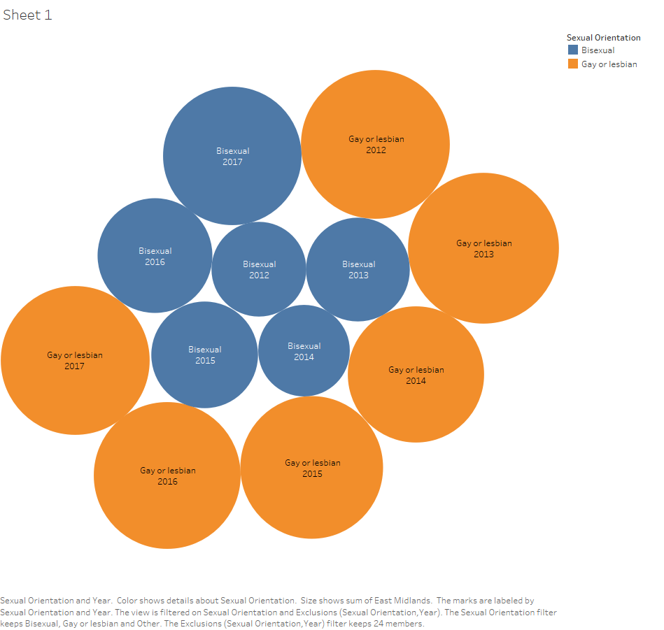
Bubble chart for Gay or Lesbian and Bisexual people in the East Midlands

Slide 4
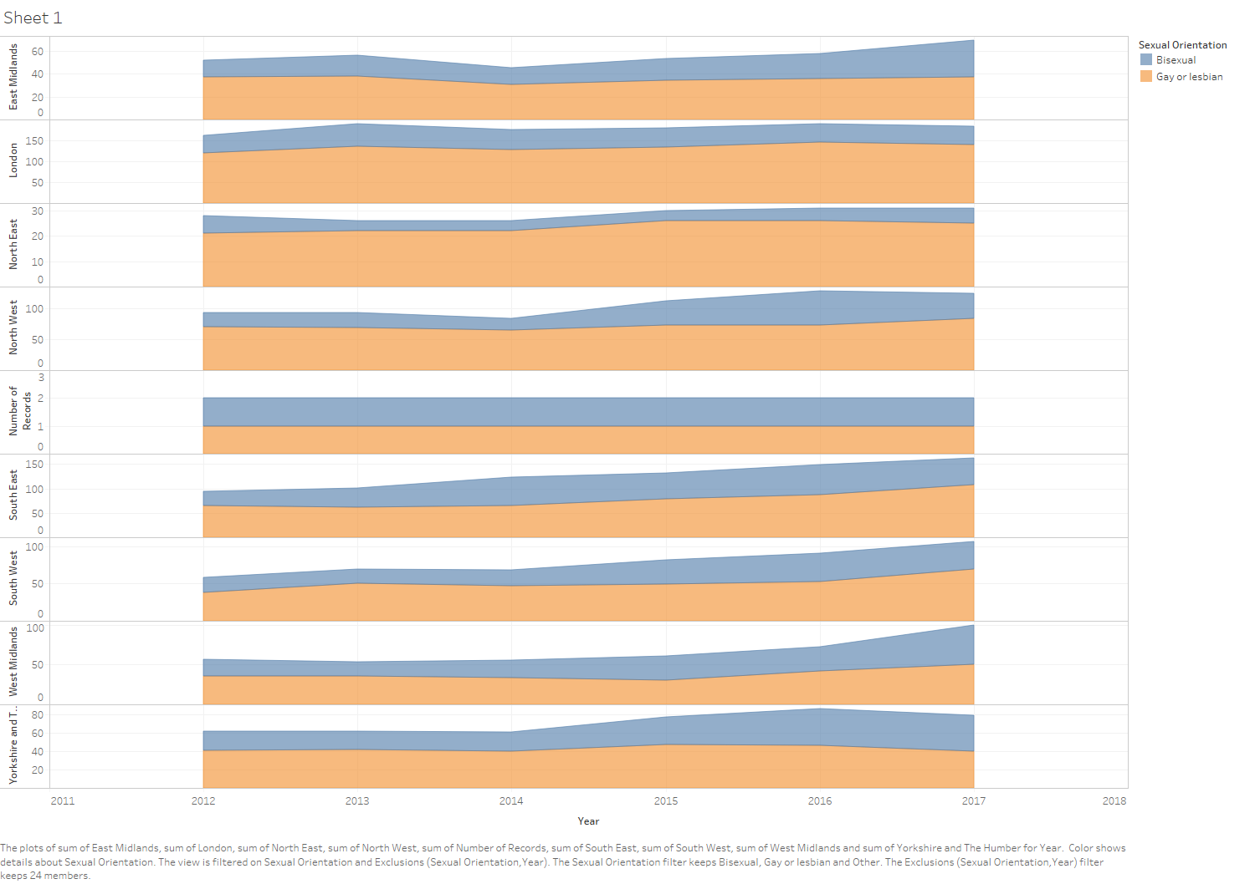
Chart for Gay or Lesbian and Bisexual people in the East Midlands

Slide 5
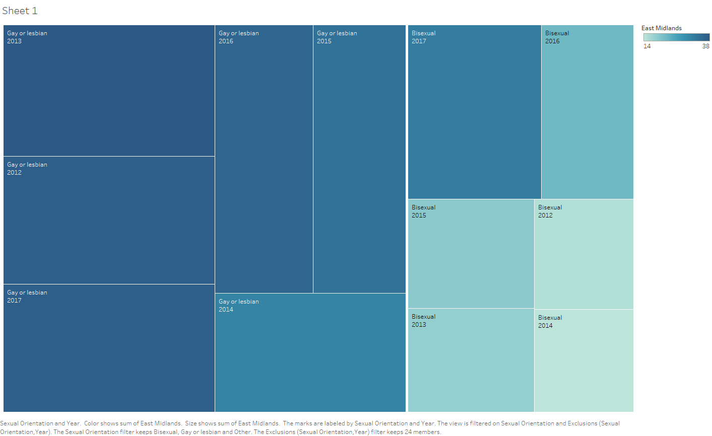
Treemap for Gay or Lesbian and Bisexual people in the East Midlands

Slide 6
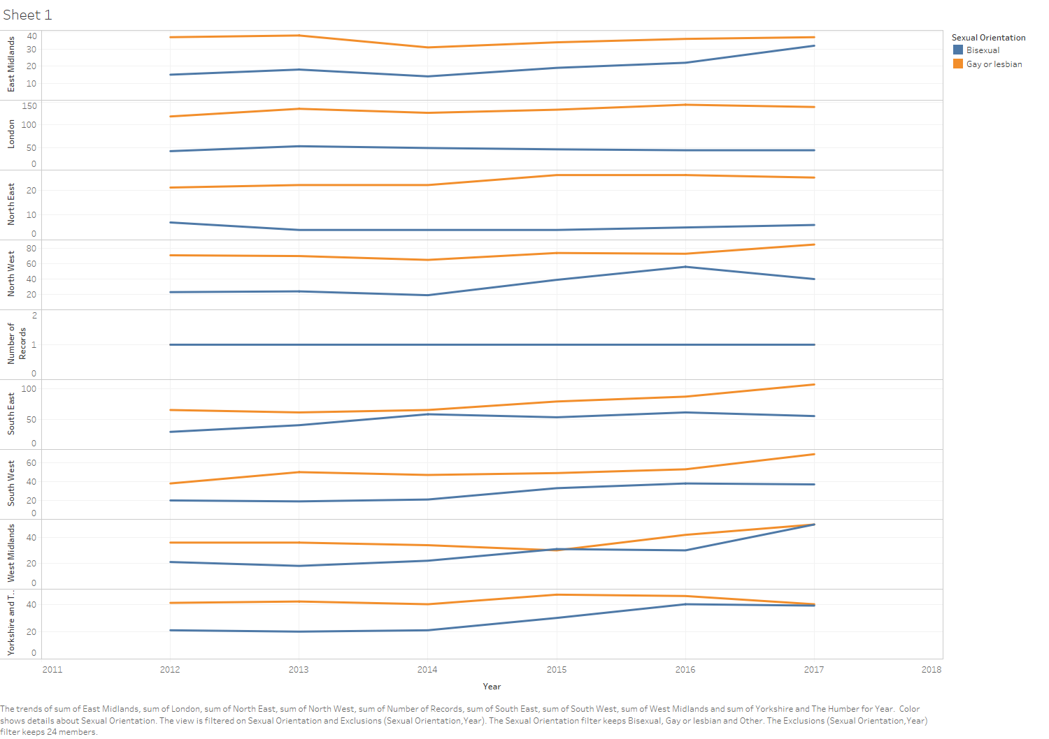
Trend line for Gay or Lesbian and Bisexual people in the English Regions

Slide 7
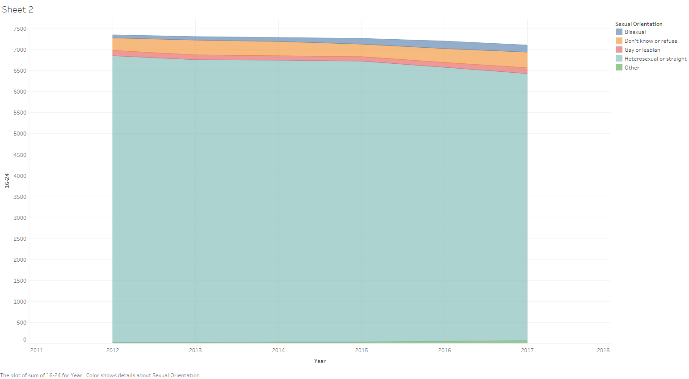
Chart for all sexual orientations aged 16-24

Slide 8
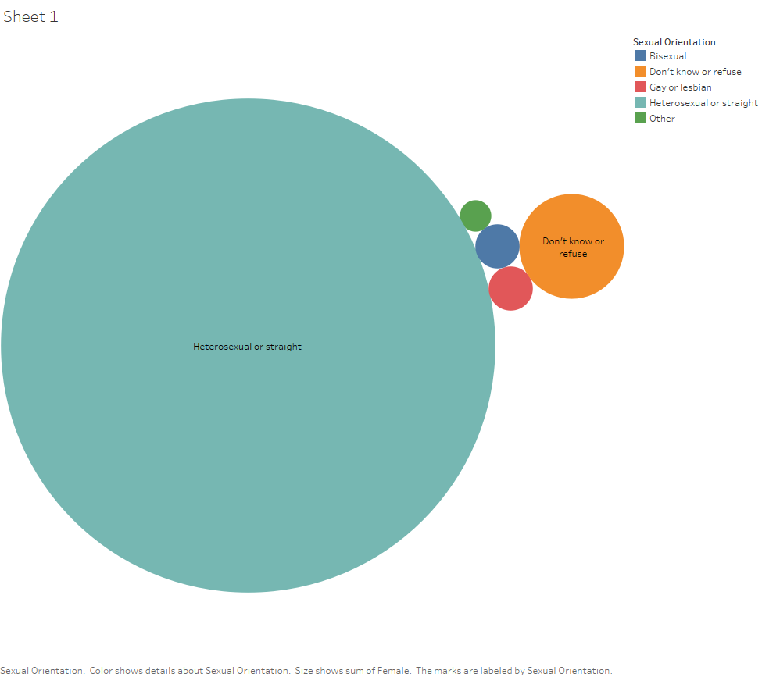
Bubble chart for all sexual orientations of women

Slide 9
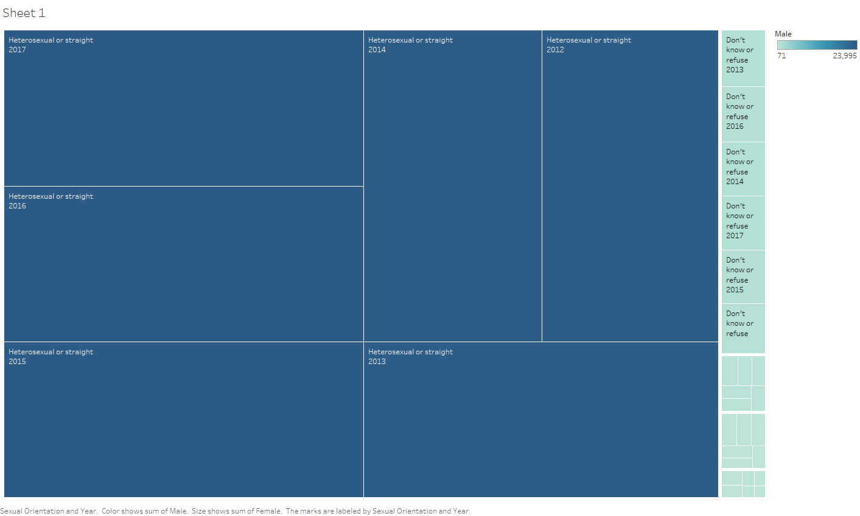
Treemap for all sexual orientations of men

Slide 10
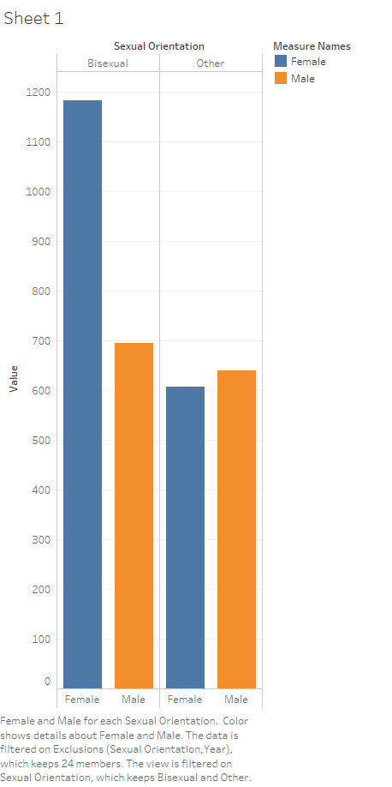
Bar chart for all sexual orientations of men

Slide 11
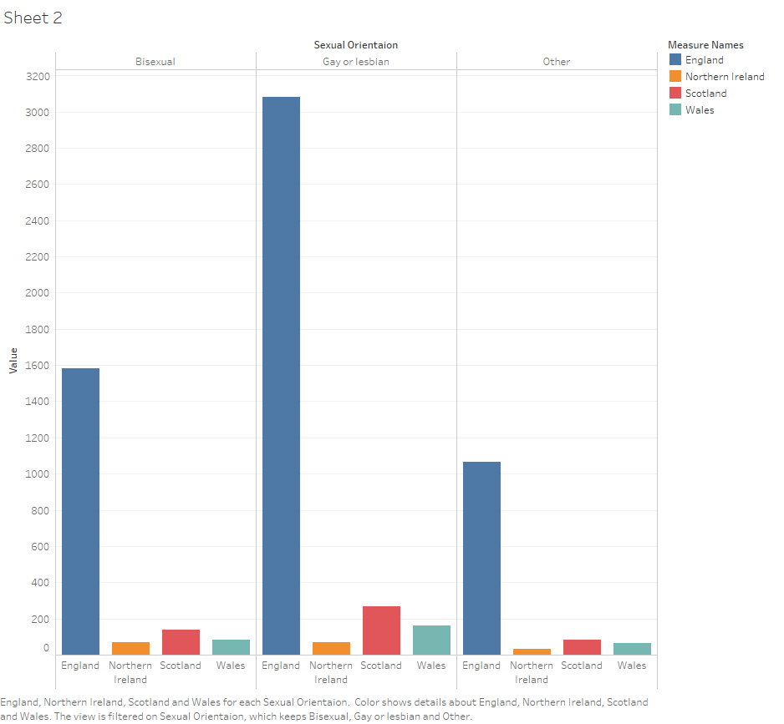
Bar chart for regions of the UK and Northern Ireland

Slide 12
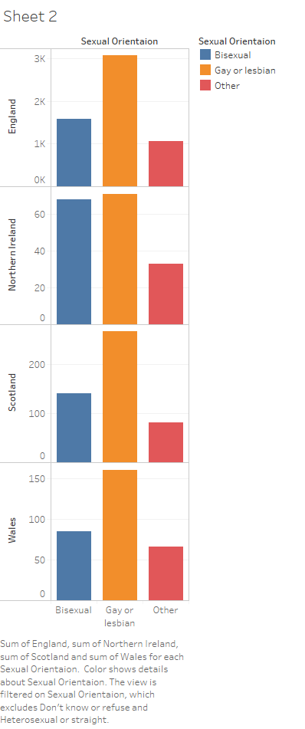
Bar chart for regions of the UK and Northern Ireland

Slide 13
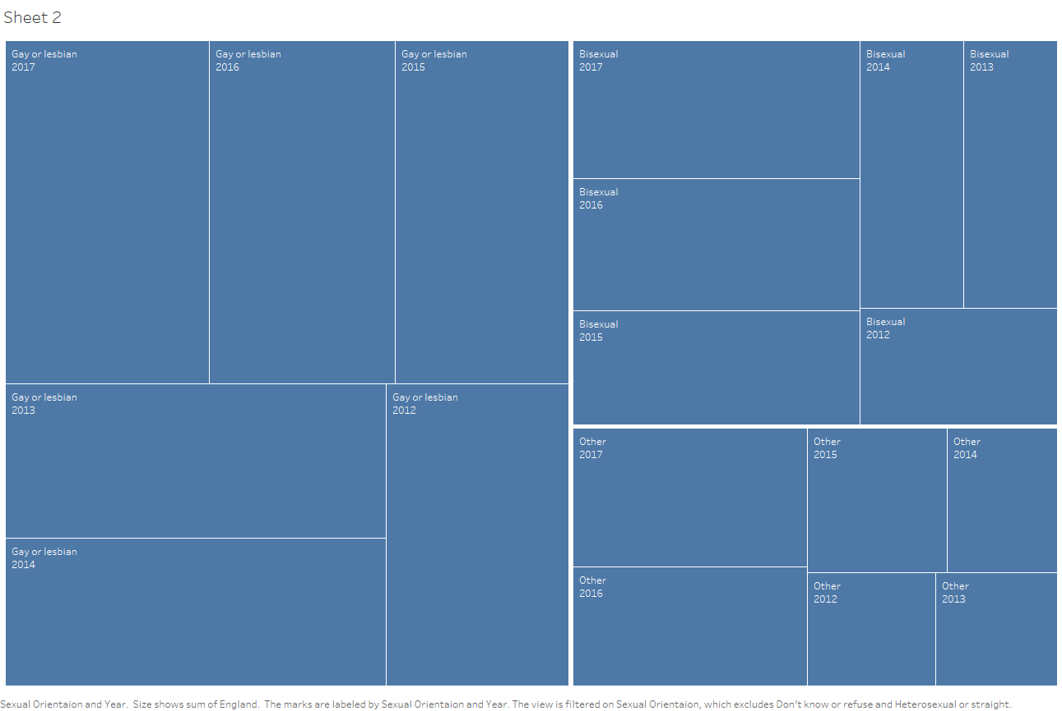
Tree chart for all sexual orientations in England

Slide 14
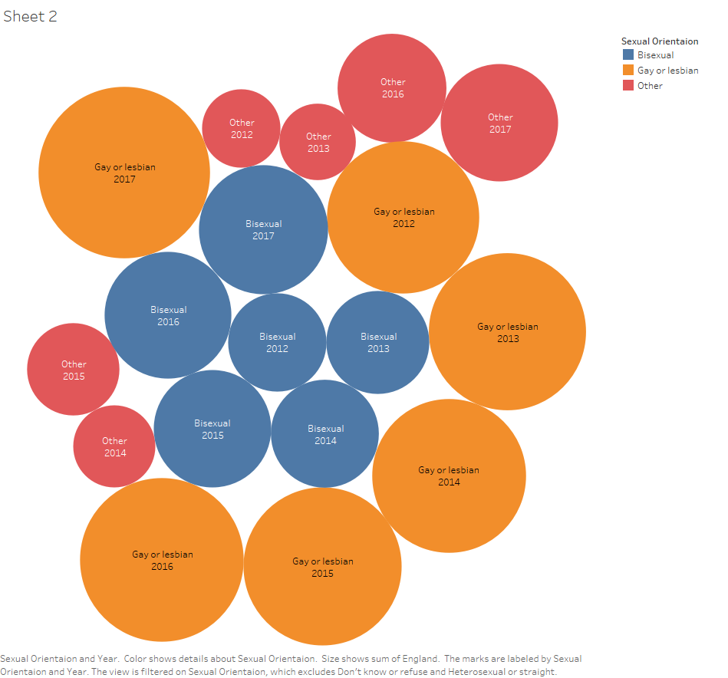
Tree chart for all sexual orientations in England

